Slide 1
ACT-A – Community/CS Representatives Platform Call August 6th 2020

Slide 2
Agenda for today’s call
Brief overview: ACT-A – its structures and CS/Community engagement to date
Updates on work to actively engage people living with COVID in this platform/conversations
Updates from different pillars
Health Systems Connector
Therapeutics
Vaccines
Diagnostics
Q&A on Pillar content and CS representation
Plans for this Platform – Updates and Discussion on Coordination and Convening

Slide 3
Our vision
support the identified civil society and community representatives in ACT-A and
provide a platform for engagement with those representatives and broader, global collaboration in bringing the expertise in civil society and communities to representatives in ACT-A and provide a space for information sharing, consultation and cohesive action and advocacy.
Notes:
ICSS was established in 2006, and is based in Amsterdam, Netherlands.
ICSS’s mission is based on the vision of a world where all people can fulfill their right to health and enjoy full and productive lives
ICSS has played a unique leadership role within the civil society response to HIV and broader global health.

Slide 4
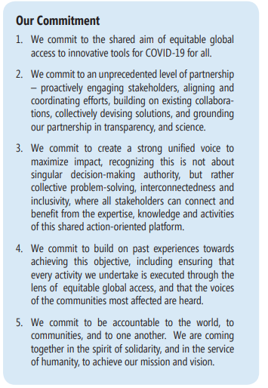
What is the Access to COVID19 Tools Accelerator (ACT-A)?
Launched in May 2020, it is envisioned as a time-limited partnership of a number of global health actors, private sector partners and other stakeholders
Notes:
ICSS aims to act as a ‘bridge-builder’ between civil society and external stakeholders, notably donors, and actively aims to provide ‘safe spaces’ for relationship-building and dialogue.
It has also been a powerful advocate for the role and needs of civil society, especially organizations and networks of key affected communities, such as sex workers, people who inject drugs and men who have sex with men (MSM).
ICSS continues to be a champion for HIV while increasing our engagement in broader health issues.

Slide 5
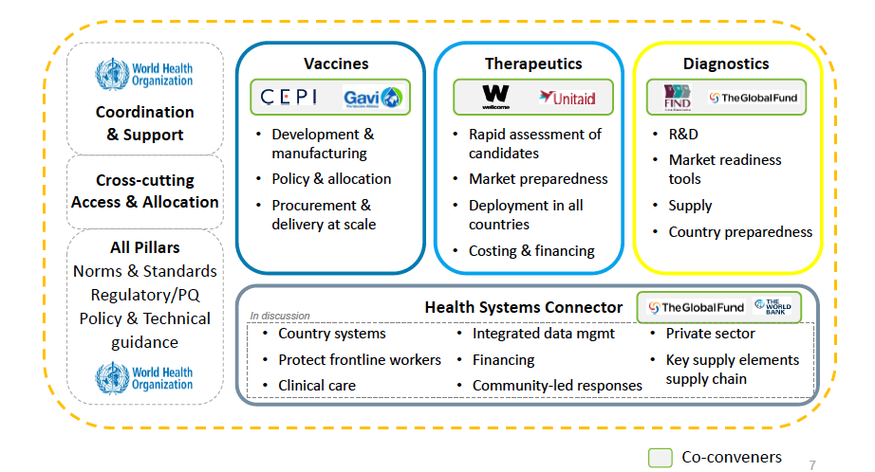

Slide 6
Platform: Work to date
June 4th – CS/Communities representatives from many of the global health agencies involved in ACT-A, sent a joint letter demanding access for CS/Community reps in each and every part of the ACT-A
Response received on July 8th – confirmed intention to include CS/Communities but was vague
https://www.globalfundadvocatesnetwork.org/tools-for-advocacy/covid-19-resources/act-accelerator-act-a/ (to be transferred to new website soon)
Vaccines – solidarity sign-on with “business case” for CS/community involvement sent with 175 organizational and individual signatories to all members of the Gavi Board before their July 30th meeting
Covid19advocacy.org
Notes:
The overall purpose of GFAN is to build a global social movement to demand health for all by recruiting, connecting and mobilizing advocates to communicate the urgent need, and demand full funding, for the Global Fund to maximize its impact. GFAN welcomes as its members all civil society organizations, Friends of the Fund groups and individuals that endorse GFAN’s goals, objectives and principles.
FSP was created to provide a safe space where networks could meet, learn from each other’s work and start developing a shared agenda, and it seeks a global HIV response that sustainably and comprehensively engages diverse segments of the communities as essential drivers of the response. Over the past 10 years, the FSP has brought together the leadership of the (now 11) global HIV civil society and KVP communities’ networks to facilitate linking and learning, shared strategizing and (increasingly) enhanced collaboration and division of labour.
The concept of a Civil Society Sustainability Network (CSSN) was developed with the idea of having a civil society-owned group of experts to advocate for and support a medium and long-term sustainability of HIV- and TB-related programming for civil society and key and vulnerable populations.

Slide 7
Vaccines
Board meeting held on July 30th, where support for CS/Community engagement was found by many around the table, key questions we look fwd to more clarification on in the coming days/weeks:
where there are now CS representatives in the Vaccine Pillar and who they are?
Did the Board “mandate” full representation of civil society based on the requests or what battles/gaps are there still to advocate for in relation to CS representation?
A Terms of Reference for the governance structures will be presented in September – understanding opportunities to shape and influence it in the interim period
Key allies – who can we as CS/Communities count on among ACT-A lead agencies and others to support the work in this pillar

Slide 9
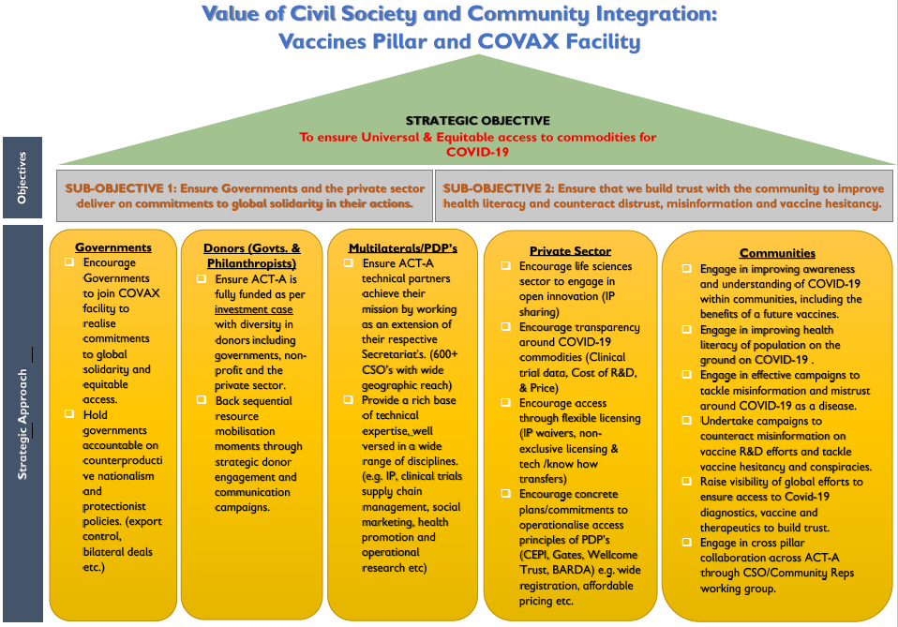

Slide 10
Diagnostics Update
Expression of Interest was issued and closed recently – considerations for further EOI to be welcomed by late August
Modelling done to make the case for Diagnostics being developed as messaging and advocacy tools
Key “new” work in this time period to understand the interplay between Dx and Tx
Significant concern remains over investments in Dx pillar
https://forms.gle/wZFta1Rosz3nYKSD7 Applications for CS/COmmunity representatives open until August 14th

Slide 12
